Slide 1

PROJRCT TITILE : BUBBLE SORT (PYTHON SORTHING METHODS) Name : Vishakha Wavhale UID No : FSRB0407

Slide 2
CONTENTS
01
02
03
04
05
INTRODUCTION
WHAT IS BUBBLE SORT
WHY BUBBLE SORT
IMPLEMENTATION
REAL TIME USES

Slide 3

SORTING ALGOTITHEMS IN PYTHON
SELECTION SORT BUBBLE SORT
INSERTION SORT MERGE SORT
SHELL SORT

Slide 4

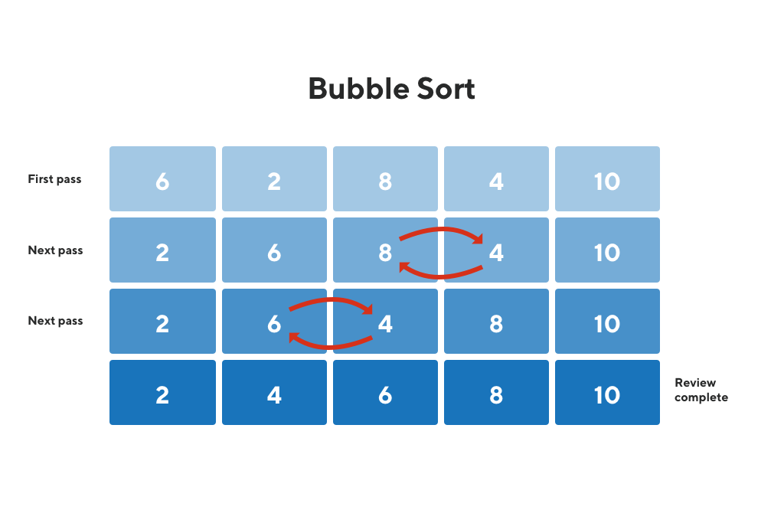



BUBBLE SORT
It is a comparison-based algorithm in which each pair of adjacent elements is compared and the elements are swapped if they are not in order.

Slide 5
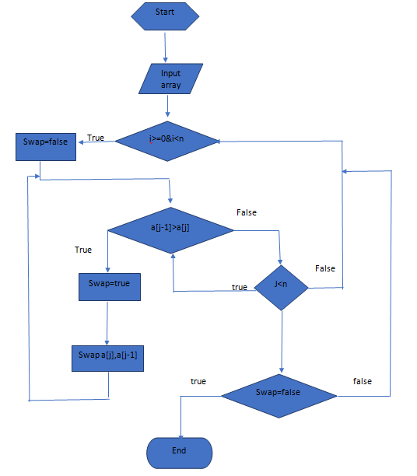
FLOWCHART

Slide 6
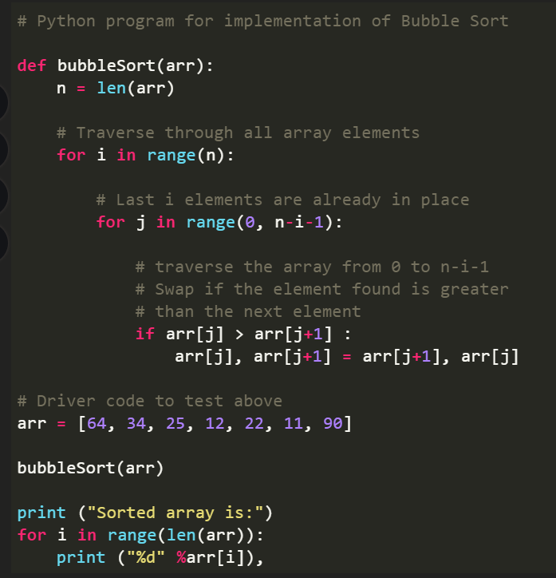
IMPLEMENTATION

